Slide 1
Haven
Now with SGX and Attestation
Jeff Chase
Duke University

Slide 3
Trust it?
You have code.
Rent a machine.
Run the code.
Is it safe?
You trust the code.
You trust the machine.
But not the owner.
Or the OS.
How to validate?
Graphic from Intel SGX Explained (Costan and Devadas, IACR Cryptology, 2016)

Slide 4
Getting to Haven
Haven provides a safe context for code execution:
Safe from a subverted OS kernel
Safe from a subverted hypervisor
Safe from a physical attack on memory! Operates on data encrypted in memory
Haven rests on new architectural foundations for trustworthy computing:
Intel SGX: Software Guard Extensions
New abstraction: enclaves
Supports attestation of code identities
New CPU mode: enclave mode for shielded execution

Slide 5
Enclaves
VM
guest kernel
host kernel / hypervisor
An enclave is a region of user VM (ring 3), loaded with a module.
Contains code and data. User calls kernel to set it up: trust but verify.
“Sealed”: no access to enclave memory except by enclave code
Gated entry: well-defined entry points for control transfer into enclave
Secure thread context (save/restore on exceptions), secure paging

Slide 6
Portrait of an enclave
Haven, OSDI 2014

Slide 8
Haven, OSDI 2014

Slide 9
Haven, OSDI 2014

Slide 10
Haven, OSDI 2014

Slide 11
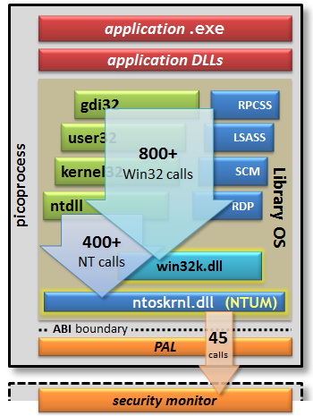
Drawbridge LibOS
Secure container
Process model
Full OS API
Narrow ABI
LibOS fills the gap
Minimal monitor
Rethinking the Library OS from the Top Down

Slide 12
Shielding the Drawbridge LibOS
Problem: Iago attacks
Can’t trust host OS
Keep most OS functions in LibOS (TCB)
→ Minimize attack surface
Trust but verify
Check every response
Verify VM actions
Handle own exceptions
Encrypt storage
Encrypt network traffic
What crypto keys?

Slide 13
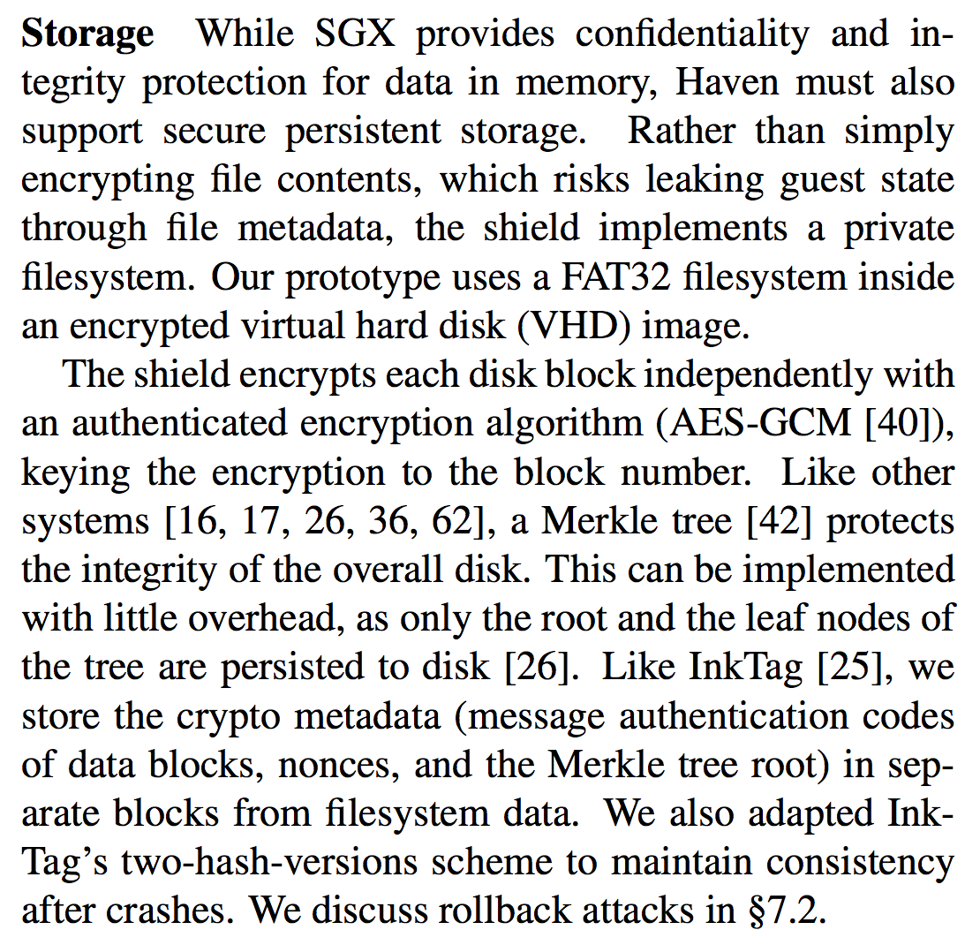
Haven’s secure storage

Slide 14



Attestation
An attestation is an authenticated statement that a given process is a safe execution of a program P.
The statement is sometimes called a “quote” or “measurement”: it contains a secure fingerprint of P and of its initial state.
Let’s us incorporate programs into the access control system: I might trust a program, independent of who is running it.
But the software entity (process?) must be “sealed”.
This concept is like Singularity’s sealed SIPs.
An attestation also includes data that enables a receiver to establish a secure channel with the running P (TLS).

Slide 15
Challenges for attestation
How to name P? How to capture its initial state?
How to authenticate the attestation statement?
Whom do we trust to make such a statement?
Can we pass attestations across a network?
How to protect P’s code/data from an attack on virtual memory?
How to establish a secure channel with the running P? What data to pass with the attestation?

Slide 16
Solutions: using crypto for SGX
Identify P and its initial state by taking a hash fingerprint over an enclave’s memory, and including it in the attestation.
But how does receiver know it can trust P?
Authenticate the attestation statement by applying a digital signature to the statement.
We trust SGX-enabled CPUs (“platform”) endorsed by Intel to make attestation statements. (How to tell?)
We can pass attestations across the network, if the receiver trusts the SGX platform signing key. (How to tell?)
Protect P’s code/data by encrypting the data blocks in memory with symmetric crypto. The platform holds the key.
Establish channel with running P using asymmetric crypto. Pass P’s public key with the attestation.

Slide 17
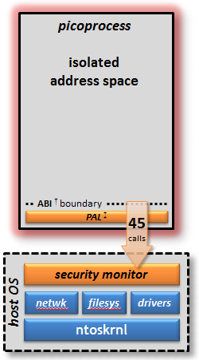

Slide 21
Graphic from Intel SGX Explained (Costan and Devadas, IACR Cryptology, 2016)

Slide 22
Graphic from Intel SGX Explained (Costan and Devadas, IACR Cryptology, 2016)

Slide 23
Note on nonces
A nonce is just a unique value we put into a message to distinguish it from all other messages: we use each nonce value at most once: nonce means "number used once”. A timestamp is an example of a nonce: the current time is different from all previous times.
The purpose of a nonce is to defend against a replay attack, in which the attacker replays a previous signed or encrypted message that is still meaningful. Even if an attacker lacks the keys to inject a valid message into a security protocol, it might be able to replay an old message to subvert the protocol somehow. A nonce defends against that because it allows the receiver to determine if a message is fresh, i.e., to detect a replayed message as invalid.
For example, in the classic challenge-response authentication protocol (similar to the military Identify Friend or Foe protocol), the challenge value is a nonce. The protocol is: I make up a nonce and send it to you as a challenge, and you decrypt it and/or encrypt/sign it and send it back, thereby proving that you possess a necessary key. The challenge value must be a nonce: if I use the same challenge repeatedly, then an attacker could overhear a valid response to an earlier challenge, and then replay the response for a future challenge.
Nonces are important. A formal analysis of the classic Needham-Schroeder authentication protocol found it to have a crucial flaw due to lack of a nonce in one step of the protocol. Note: this protocol addresses the problem raised in the challenge-response slides: it establishes a shared secret between two parties via brokering by a trusted intermediary. It is similar to the protocol used in Shibboleth Web Single Sign On (e.g., for Duke NetIDs): the trusted intermediary is a Shibboleth identity provider.

Slide 24
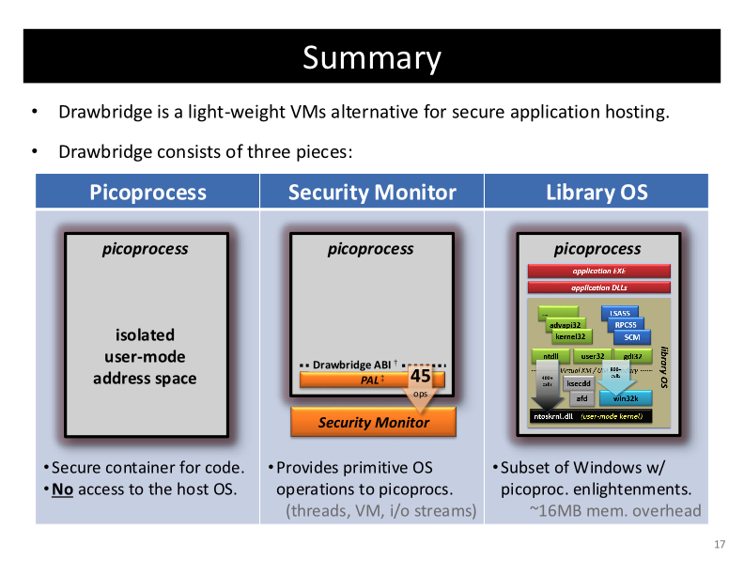

Slide 25
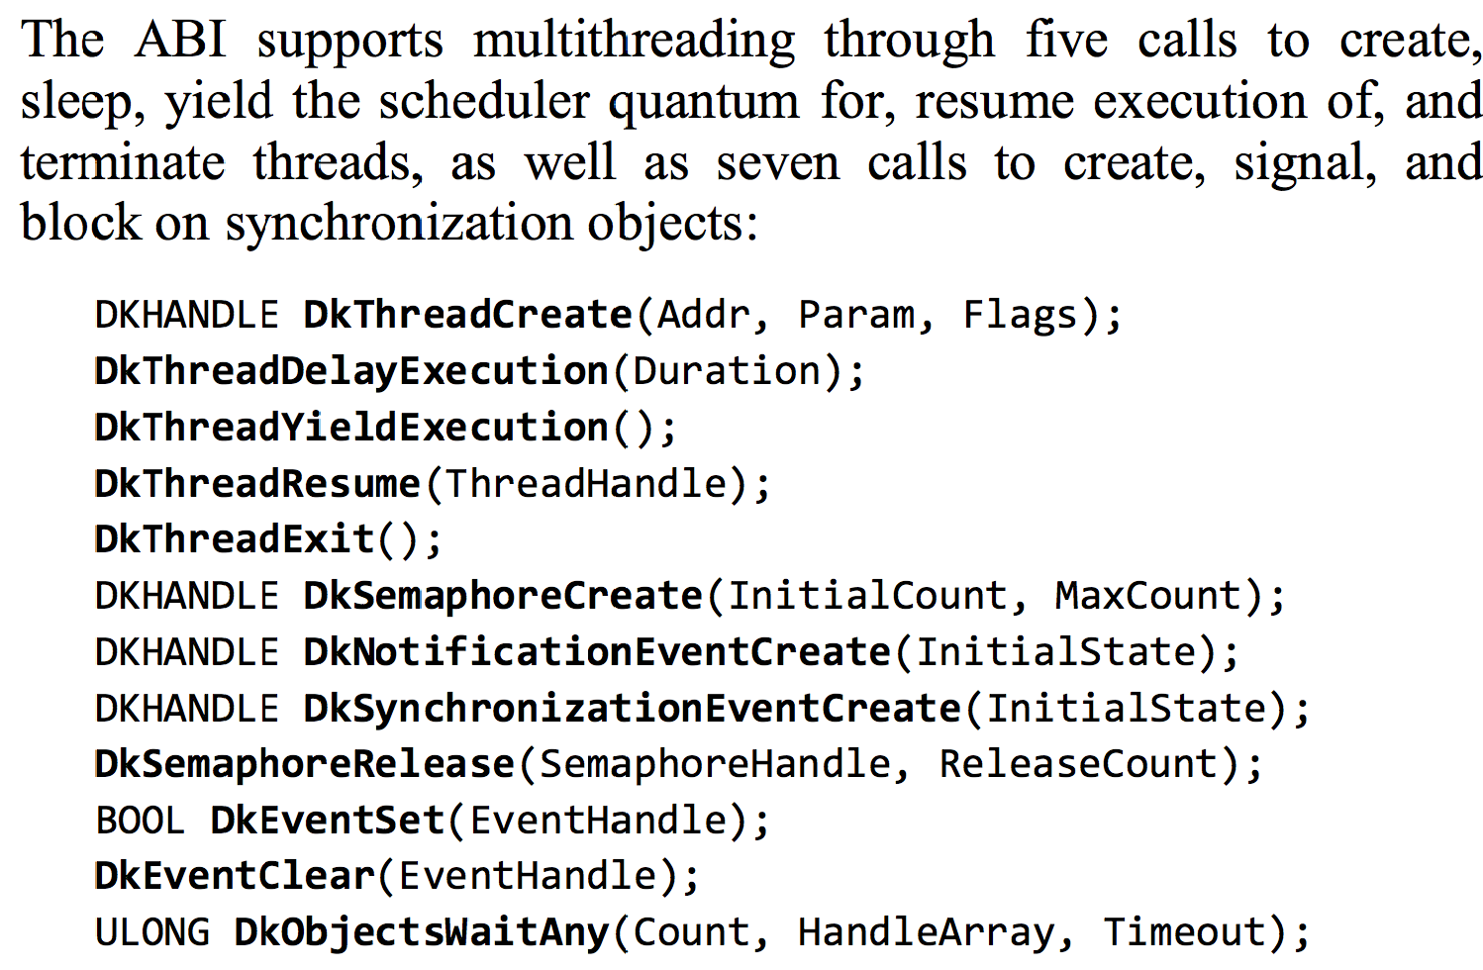
Drawbridge thread ABI/API

Slide 26
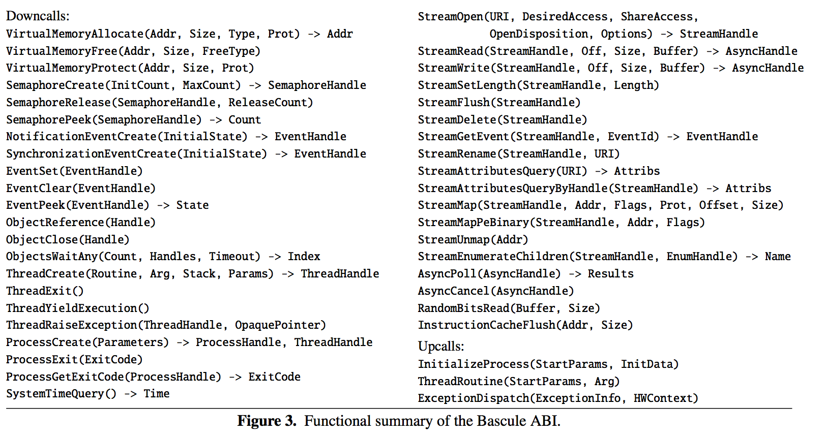
Bascule thread ABI (refines Drawbridge)

Slide 27
Bascule/Drawbridge thread ABI

Slide 28
Bascule/Drawbridge semaphore ABI

Slide 29
Bascule/Drawbridge event ABI

Slide 30
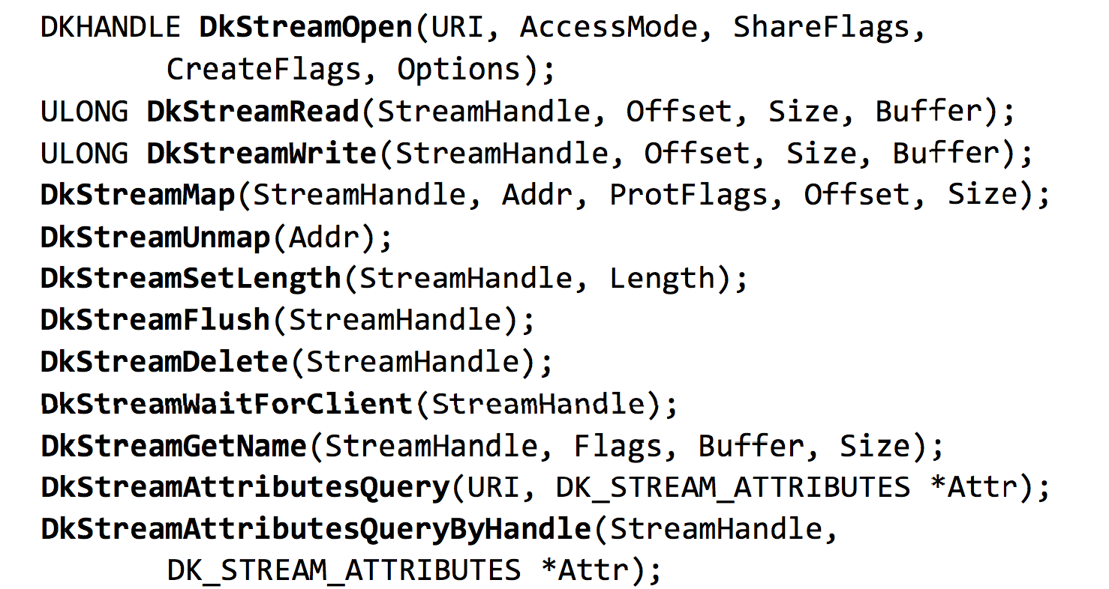
Drawbridge I/O: streams
The primary I/O mechanism in Drawbridge is an I/O stream. I/O streams are byte streams that may be memory-mapped or sequentially accessed.
Streams are named by URIs…Supported URI schemes include file:, pipe:,
http:, https:, tcp:, udp:, pipe.srv:, http.srv, tcp.srv:, and udp.srv:. The latter four schemes are used to open inbound I/O streams for server applications:

